Slide 1
Netflix’s SimianArmy
Open Source Project Group 5

Slide 2
Outline
Introduction / Overview of Simian Army (George) * including System Architecture
Initialization (David)
Chaos Monkey (Allen)
Conformity Monkey (Amity)
Janitor Monkey (David)
Client Module and multi-thread handling (Terry)
Crawler Module (Joe)
Utilities Module (George, David) * including NotFoundExceptions
Coding Style (Whole Group)

Slide 3
Background Information
Created by Netflix after moving to AWS to improve availability & reliability.
A cloud architecture, where individual components fail but do not affect the availability of the entire system, was greatly needed.
Infrastructure is never 100% reliable but streaming must be non-stop.
SimianArmy deploys “monkeys” to make cloud service less fragile and better able to support continuous service when some parts have issues.
Potential weaknesses and/or problems could be detected and addressed.

Slide 4
Analogy by Netflix
Is your spare tire properly inflated when necessary?
How do you know? Do you have the tools to change it? Can you?
One way to guarantee the above questions is to poke a hole in your tire once a week and go through the drill of replacing it.
Expensive and time-consuming in the real world.
Almost free and automated in the cloud.
This philosophy led to development of SimianArmy.
*Source: < http://techblog.netflix.com/2011/07/netflix-simian-army.html >

Slide 5
Members of the SimianArmy
Chaos Monkey – randomly shuts down VMs to ensure that small disruptions will not affect the overall service.
Conformity Monkey – detects instances that aren’t coded to best-practices and shuts them down, giving the service owner the opportunity to re-launch them properly.
Janitor Monkey – searches for unused resources and discards them.
Security Monkey – searches security weaknesses, and ends the offending instances.
Doctor Monkey – performs health checks on each instance and monitors other external signs of process health such as CPU and memory usage.
Latency Monkey – simulates a degradation of service and checks to make sure that upstream services react appropriately.

Slide 6
Architecture Expression
Module | Descriptions
Client Module | Provides functionality/interface that allows the monkeys to interact with the cloud.
Resource Module | Provides functionality of getting the common properties of a resource and the methods to add and retrieve additional properties of one.
Chaos Monkey Module | Provides functionality of creating different types of chaos on AWS, thus causing small disruptions and testing ability to withstand such unexpected events.
Janitor Monkey Module | Provides functionalities of searching for unused resources, marking of them, and cleaning up.
Conformity Monkey Module | Provides functionalities of getting clusters, as well as applying a set of rules to perform conformity checks. A cluster is the basic unit of conformity check.
Crawler Module | Provides functionality of getting auto-scaling-groups from AWS. Retrieves information of such instances, for usages by Janitor Monkey.
Utilities Module | Provides functionalities of scheduling monkeys deployment, recording and finding events in data storage as well as notifying admins via email.

Slide 7
System Architecture Diagram
Crawler Module
Client Module
Utility – Event Scheduler
Resource Module
AWS
Chaos Monkey
Conformity Monkey
Janitor Monkey
Database
Utility – Recorder
Utility – Email Notifier

Slide 8
Initialization

Slide 9
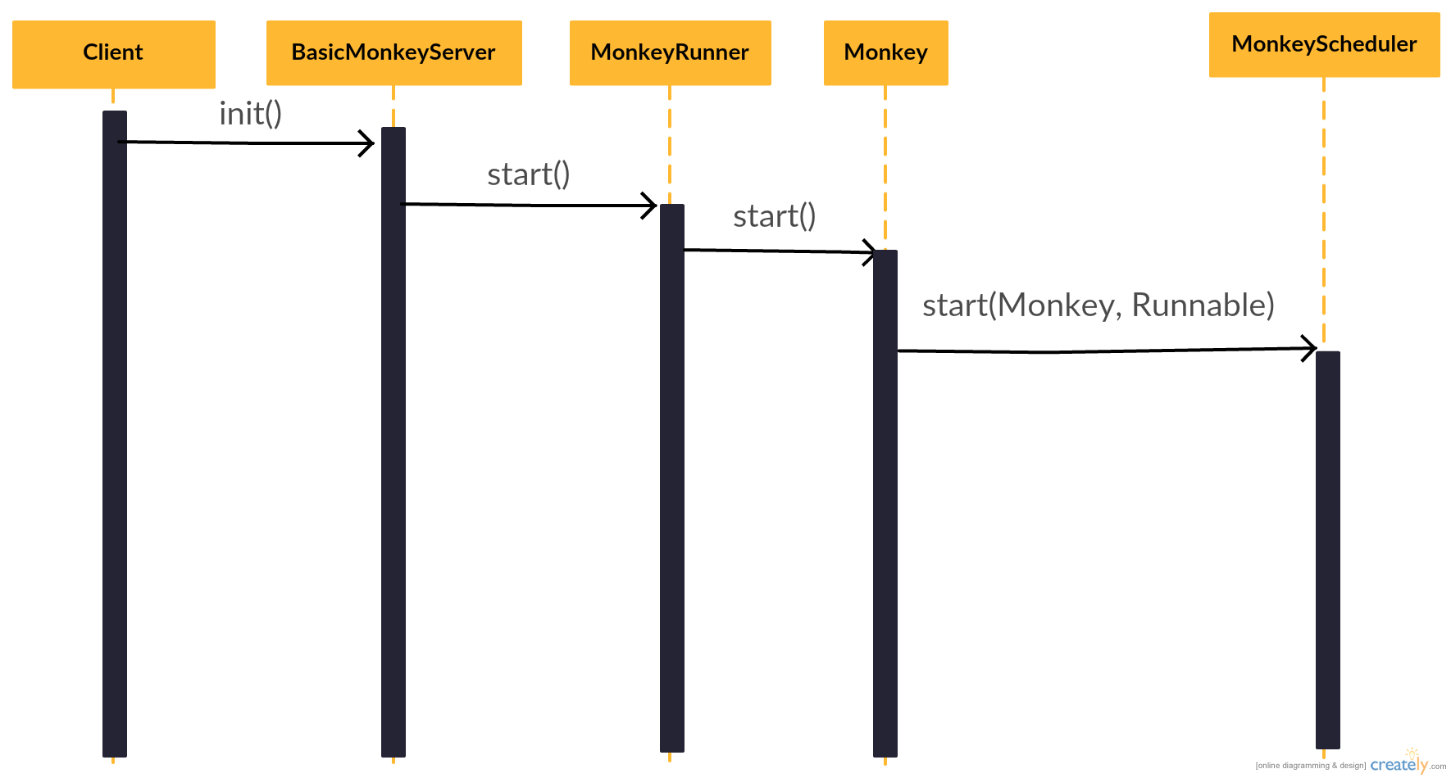
Sequence Diagram

Slide 10
Class Diagram
Notes:
BasicMonkeyServer overrides init() and destroy(), in init() it loads configuration and call start() of MonkeyRunner
Monkey start() uses run(), and run() will handle scheduler and EventReport then calls doMonkeyBusiness()
Monkey gets an scheduler from its inner interface Context

Slide 11
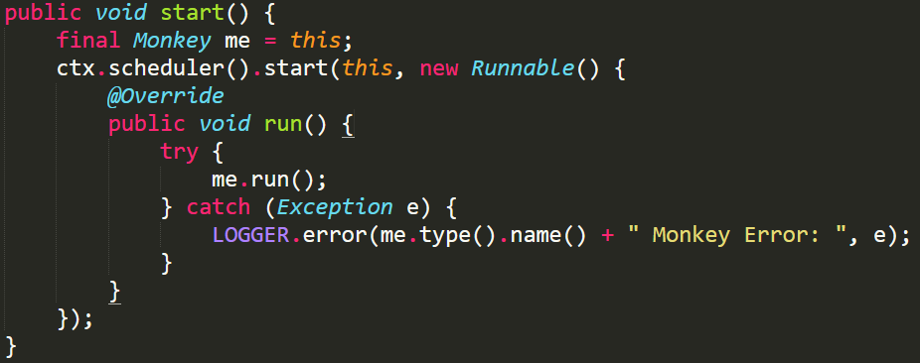
Command Pattern (?)
Receiver (Monkey) with an action (run) ?
Notes:
Final -> to access ‘me’ in anonymous class

Slide 12
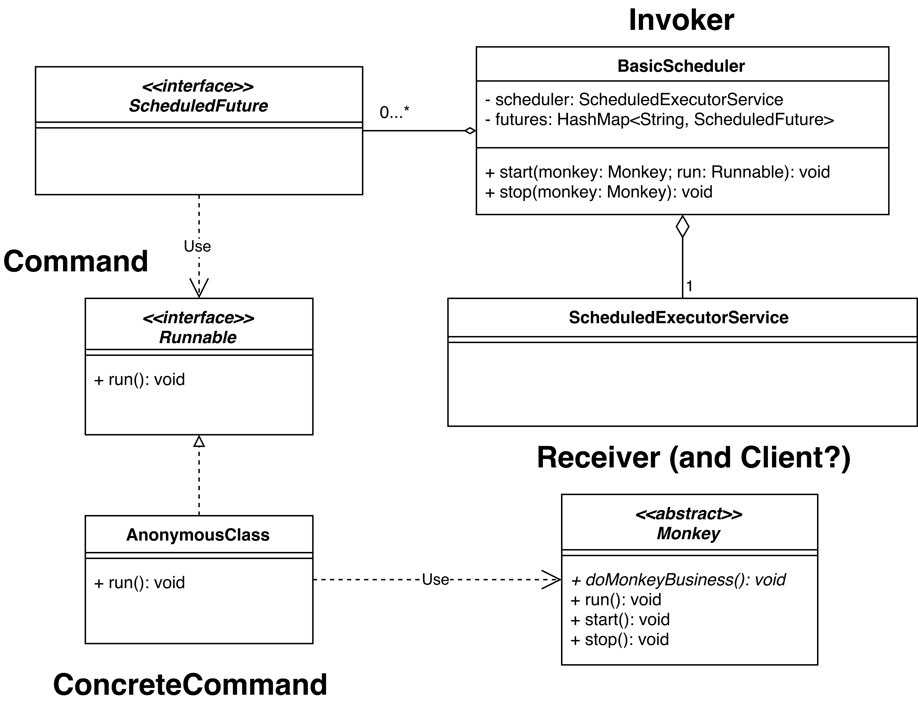
Command Pattern - Class Diagram
Notes:
BasicScheduler uses ScheduledExecutorService to turn Runnable into ScheduledFuture
BasicScheduler keeps a HashMap to stop execution of threads

Slide 13
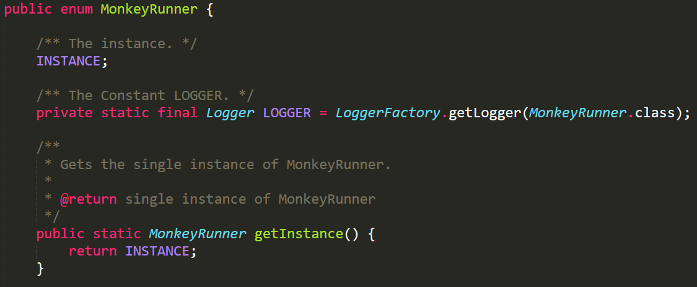
Singleton Class
MonkeyRunner

Slide 14
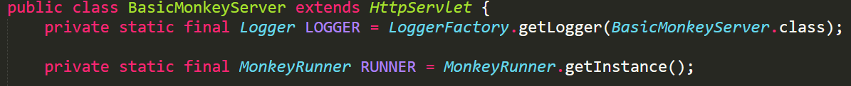
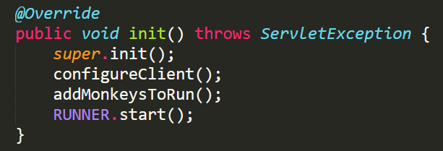
Client
BasicMonkeyServer

Slide 15
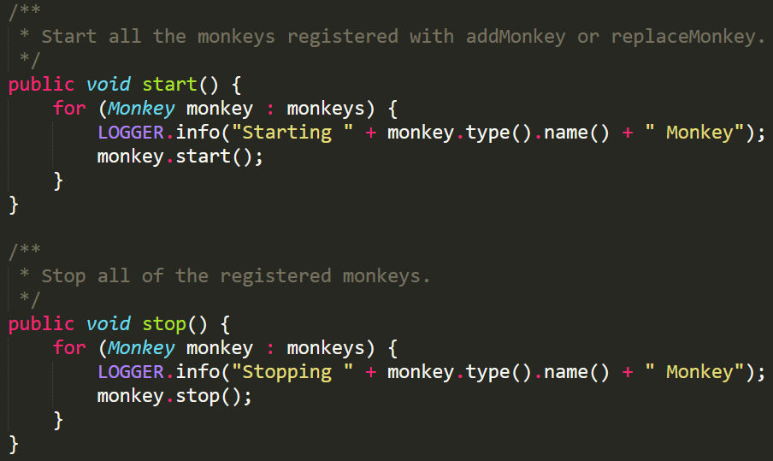
Role of MonkeyRunner
In charge of all monkeys

Slide 16
Enum Singleton
Easy to write.
Lazy loaded.
Thread-safe.
Automatically handle serialization.
Notes:
相較 double check locker
Enum 裡面每一個 Instance 都是第一次被 referenced 的時候才 instantiated
後兩項由 JVM 保證 (Enum)
//readResolve to prevent another instance of Singleton private Object readResolve(){ return INSTANCE; } Read more: http://javarevisited.blogspot.com/2012/07/why-enum-singleton-are-better-in-java.html#ixzz4hrkzyHYW

Slide 17

Chaos Monkey

Slide 18
Outline
What is Chaos Monkey
Identifies groups of systems
Randomly terminates one of the systems in a group
Why is Chaos Monkey required
Failures happen
Even if your architecture can tolerate a system failure, are you sure it will still be able to next week, next month?
Do your traffic load balancers correctly detect and route requests around system failures?

Slide 19
Design
Design Pattern:
Strategy Pattern
Design Principles:
Encapsulate what varies.
Depend on abstractions. Do not depend on concrete classes.

Slide 20
Requirements Statements
Chaos Monkey is a tool which simulates failures on a group of AWS instances randomly.
Chaos Monkey can generate failures with different types of chaos, such as Burn-CPU-Chaos which can make CPU always busy, Fill-Disk-Chaos which can make disk out of space, Block-Network-Chaos which can make the network disable.
Chaos Monkey should check that the chaos can be apply on instance before generate failures.
Some of Chaos Type are implemented with running a script over SSH, some of Chaos Type are implemented with calling AWS’s API.

Slide 21
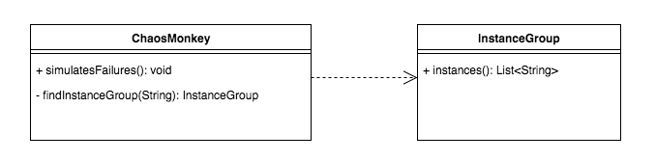
Requirements Statements₁
Chaos Monkey is a tool which simulates failures on a group of AWS instances randomly.

Slide 22
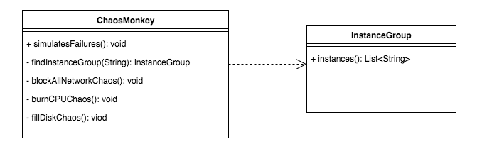
Requirements Statements₂
Chaos Monkey can generate failures with different types of chaos, such as Burn-CPU-Chaos which can make CPU always busy, Fill-Disk-Chaos which can make disk run out of space, Block-Network-Chaos which can make the network disable.

Slide 23
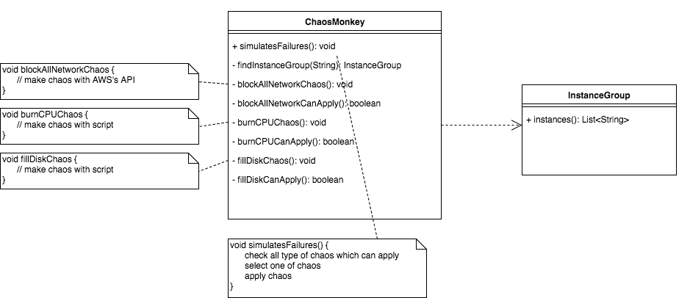
Requirements Statements₃
Chaos Monkey should check that the chaos can be applied on instance before generating failures.

Slide 24
Requirements Statements₄
Some of Chaos Type are implemented with running a script over SSH, some of Chaos Type are implemented with calling AWS’s API.
Some of Chaos Type are implemented with running a script over SSH, some of Chaos Type are implemented with calling AWS’s API.

Slide 25
Initial Design

Slide 26
Problem with Initial Design
Problem: It's difficult to add new type of Choas and vary existing ones when Chaos is an integral part of ChaosMonkey.

Slide 27
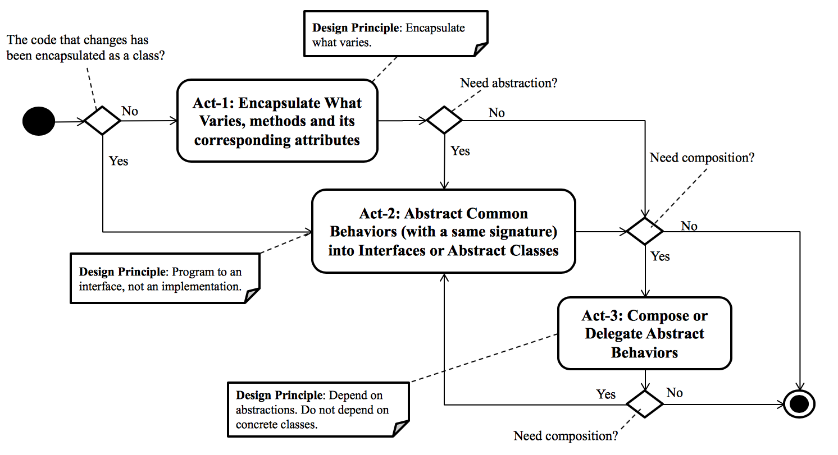
Design Process for Change

Slide 28
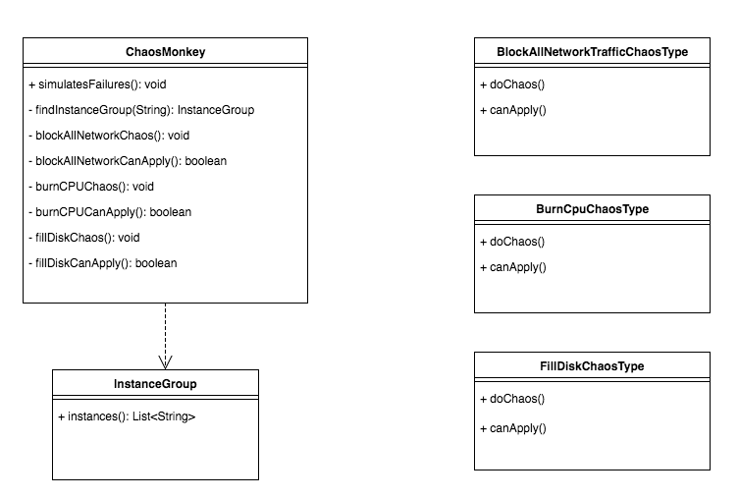
Design Process for Change
Encapsulate a method into a concrete class

Slide 29
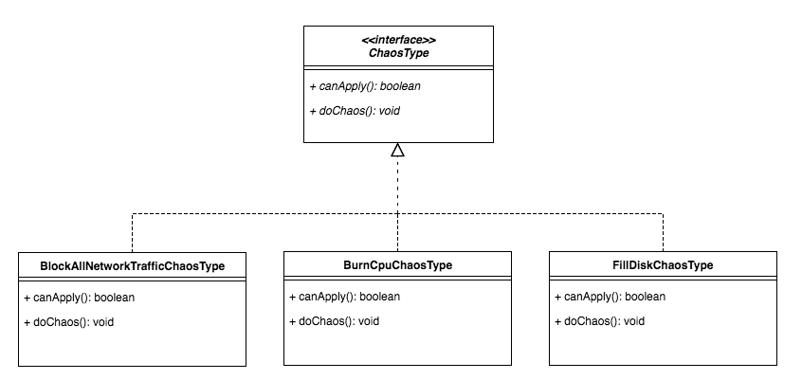
Act-2: Abstract Common Behaviors
Abstract common behaviors with a same signature into interface through polymorphism.

Slide 30
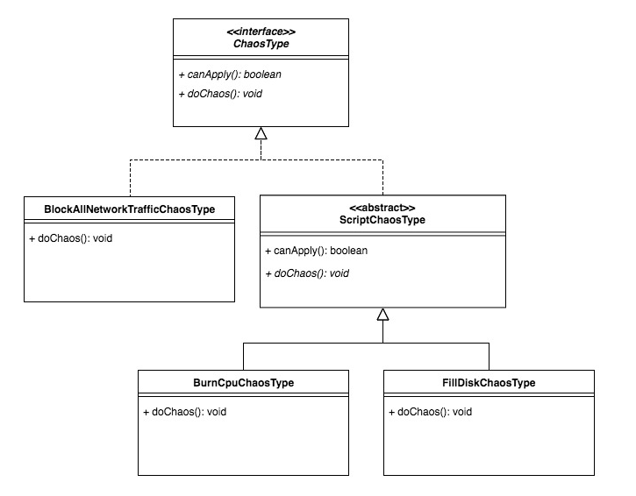
Act-2: Abstract Common Behaviors
Abstract common behaviors into abstract class.

Slide 31
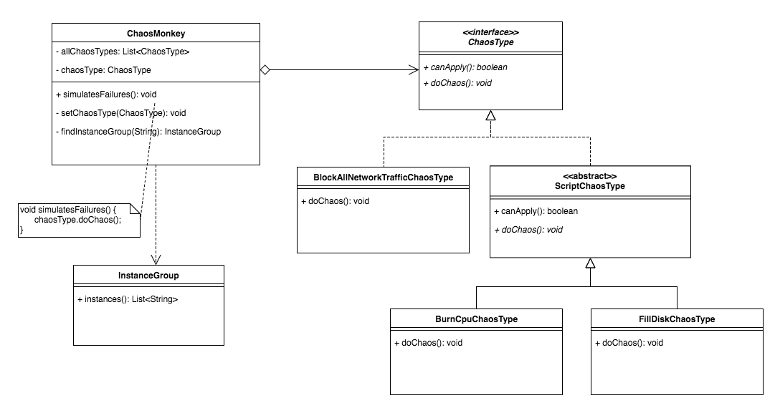
Act-3: Compose Abstract Behaviors
Compose behaviors of an interface.
A setter method.

Slide 32
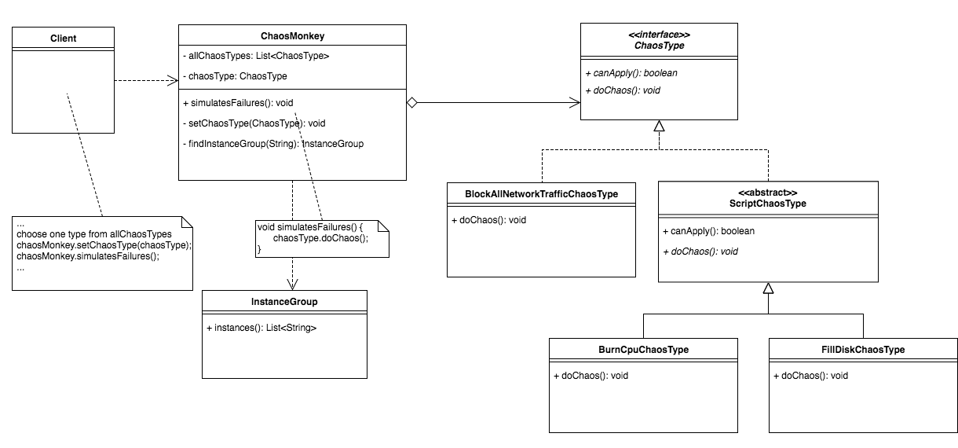
Refactored Design after Design Process

Slide 33
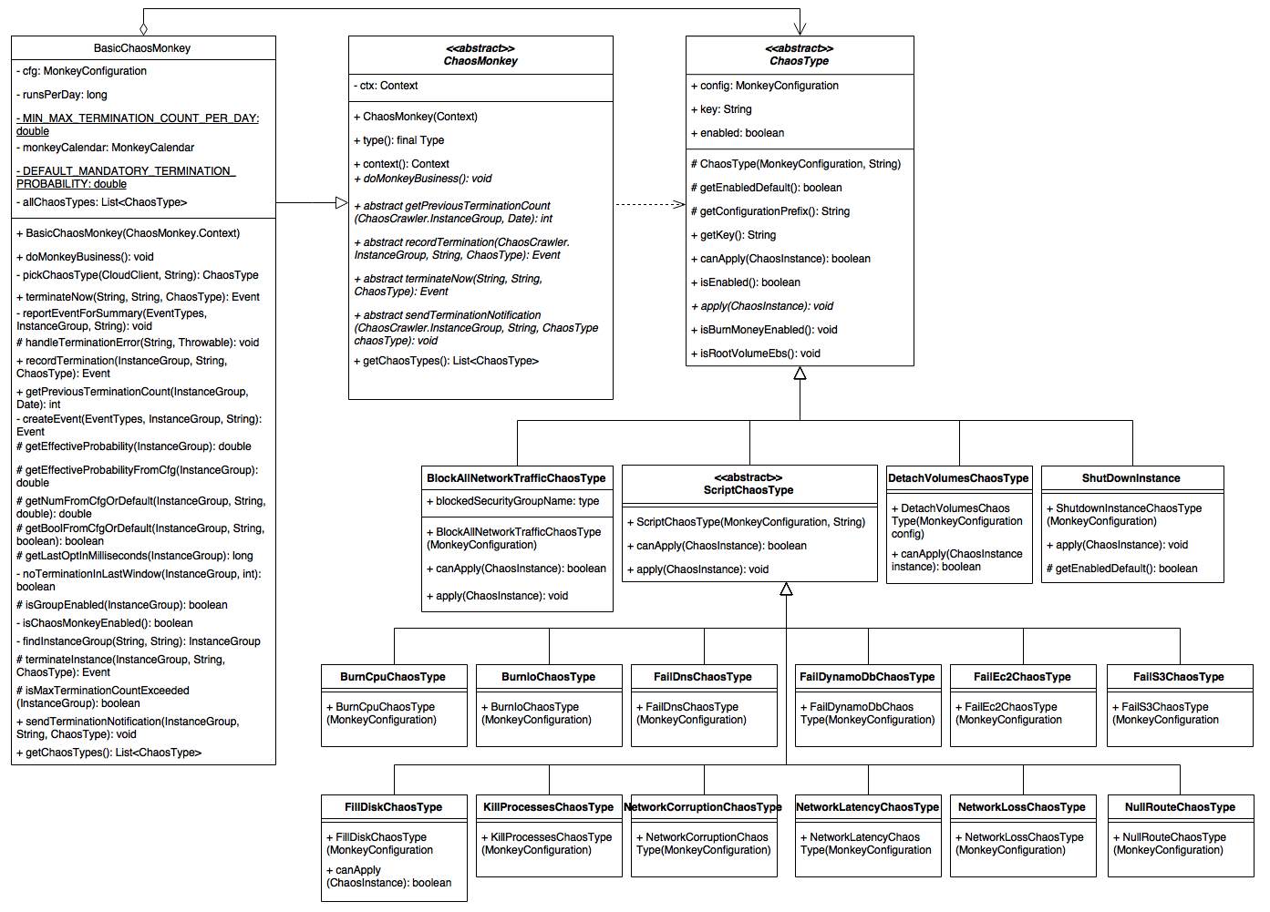
Class Diagram

Slide 34
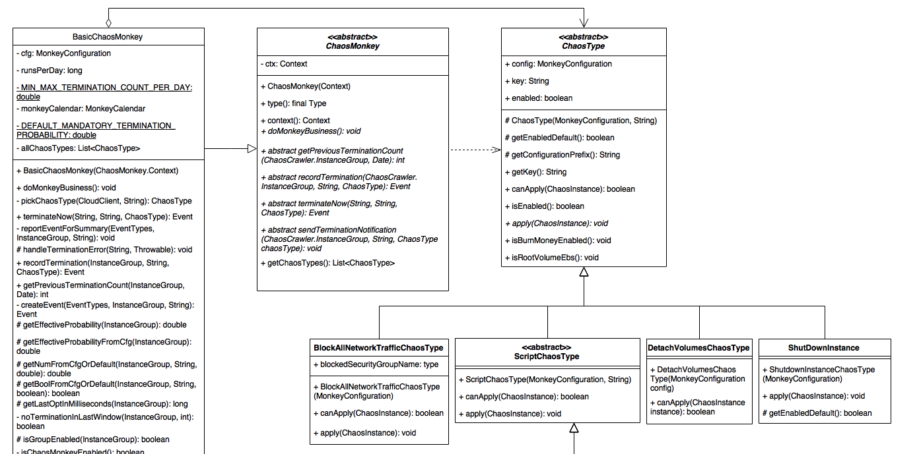

Slide 35
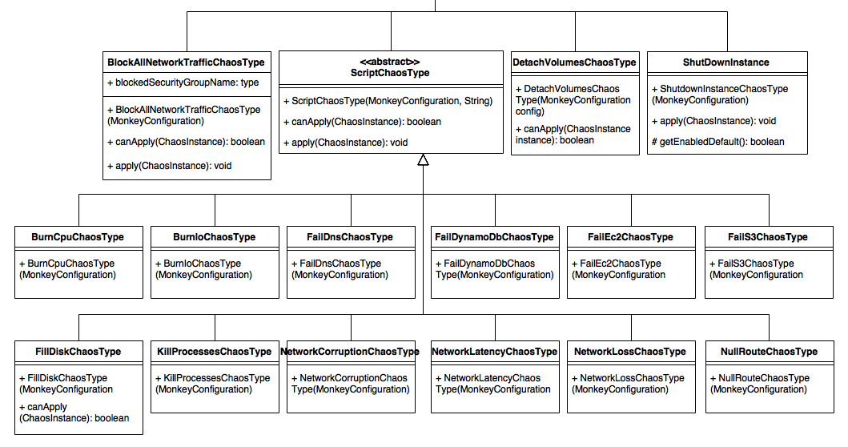

Slide 36
Conformity Monkey

Slide 37
Outline
Introduction
Requirements for Conformity Monkey
Initial Design
Refactored Design from Simian Army Developers
Problems
How to use custom rules in Conformity Monkey
How to replace Auto Scaling Groups

Slide 38
Introduction
What is Conformity Monkey?
A service running on AWS cloud.
Provides a conformity check.
Why is Conformity Monkey required?
Check if the applications or instances are launched according to the conforming rules.
How Conformity Monkey works?
Marks and then Notifies.

Slide 39
Requirements for Conformity Monkey₁
Conformity Monkey determines whether an instance in clusters is nonconforming by applying a set of rules on it. If any of the rules determines that the instance is not conforming, the monkey marks the instance and sends an email notification to the owner of the cluster.
Cluster is the basic unit of conformity check. It includes a single ASG or a group of ASGs and an ASG includes one or many instances. Each cluster has an owner.
Cluster
ASG
ASG
instance
instance
instance
instance
Notes:
Instance: A single server or machine that is part of the group of machines subject to autoscaling.
Autoscaling group: The collection of instances subject to autoscaling, along with all the associated policies and state information

Slide 40
Requirements for Conformity Monkey₂
Rule InstanceIsHealthyInEureka checks if all instances in the cluster are healthy in Discovery.
Rule InstanceHasHealthCheckUrl checks if all instances in a cluster has health check url in Discovery/Eureka.
Rule InstanceHasStatusUrl checks if all instances in a cluster has status url.
Rule InstanceInSecurityGroup checks whether or not all instances in a cluster are in specific security groups.
Rule InstanceTooOld checks if there are instances that are older than certain days. Instances are not considered to be permanent in the cloud, so sometimes having too old instances could indicate potential issues.
Rule SameZonesInElbAndAsg checks if the zones in ELB and ASG are the same.
Rule InstanceInVPC checks if an instance (a SoloInstance or an instance in ASG) is in a virtual private cloud.
Rule CrossZoneLoadBalancing checks if the cross-zone load balancing is enabled for all cluster ELBs (Elastic Load Balancer).

Slide 41
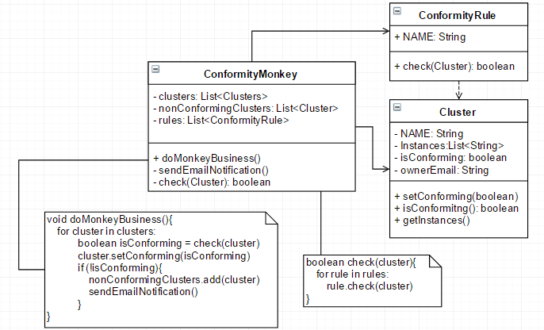
Requirements₁
Conformity Monkey determines whether an instance in clusters is nonconforming by applying a set of rules on it. If any of the rules determines that the instance is not conforming, the monkey marks the instance and sends an email notification to the owner of the cluster.
Notes:
check: loop the rules and check是否符合這些rules
doMonkeyBusiness: mark
sendEmailNotification: send notification to the owner of the cluster

Slide 42
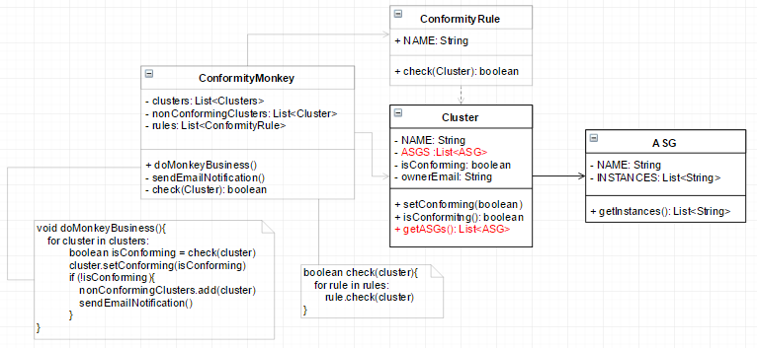
Requirements₂
Cluster is the basic unit of conformity check. It includes a single ASG or a group of ASGs and an ASG includes one or many instances. Each cluster has an owner.

Slide 43
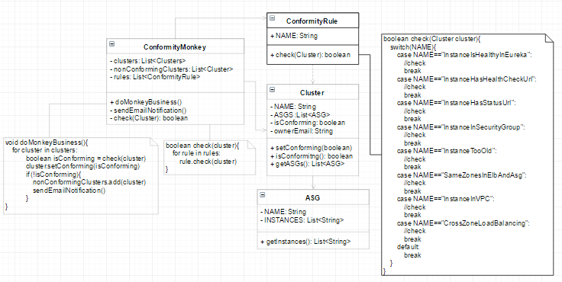
Requirements₃
Each rule has its name and its checking mechanism
Notes:
不同的rules有其不同的定義，根據rules的Name來分辨要進行何種conformity check

Slide 44
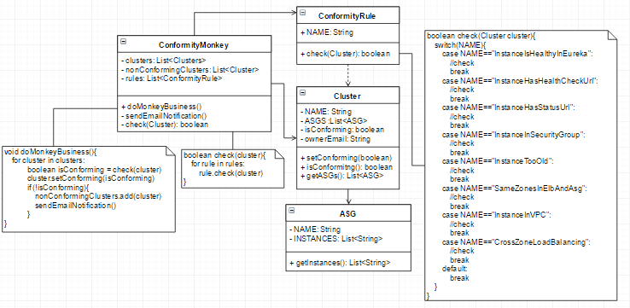
Initial Design
Violates
Dependency Inversion Principle
Violates
Open/Closed Principle

Slide 45
Refactor Design
Each rule has their own check mechanism.
The design of Conformity Monkey has to make it simple to customize rules or to add new ones.
Open/Closed Principle:
Add new rules without changing the rest of the system.
Dependency Inversion Principle:
Program to an interface, not an implementation.

Slide 46
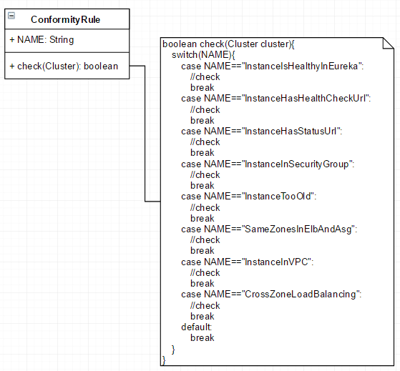
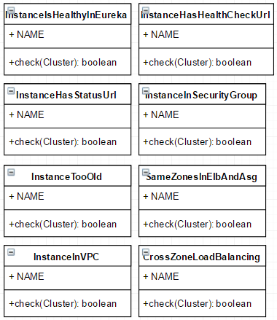
Act-1: Encapsulate what varies

Slide 47
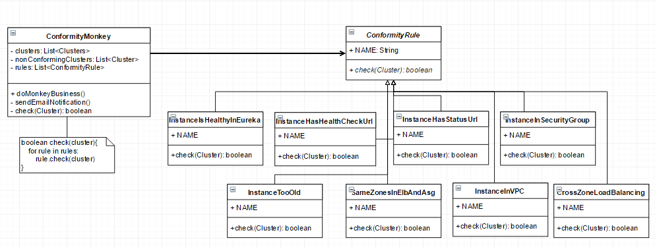
Act-2: Abstract Common Behaviors
Dependency Inversion Principle:
Program to an interface, not an implementation.
Open/Closed Principle:
Add new rules without changing the rest of the system.
Notes:
High module can’t depends on low module.
It should depends on abstraction or interface.

Slide 48
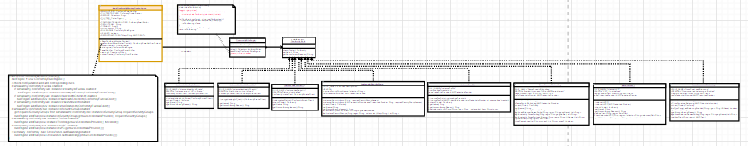
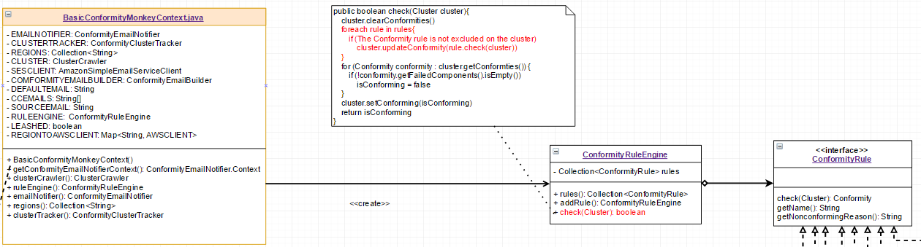
Act-3: Use a rule engine as an evaluator
client: ComformityMonkey

Slide 49
Advantages of using Rule Engine
Hides data and implementation details from client.
If a rule has to be checked dynamically according to the current state, there will be an if-else chain in the client; it is difficult to manage the rules.
With the rule engine, we can encapsulate the operations of the rules. Therefore, the client only interacts with the rule engine to do conformity check.
Notes:
我們不需要知道rule engine是如何add rules、如何運作check conformity for all rules
如果今天有一些rules在判斷是否符合時，是需要去check目前的states，導致許多if-else chain出現在check function中，因此需要有rule engine來將複雜的implementation從client中抽出來，統一管理

Slide 50
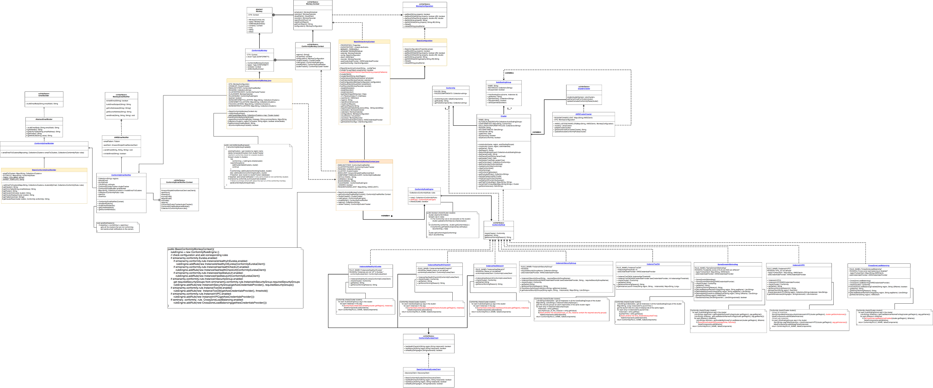
Final Class Diagram of Conformity Monkey
Designed by Developers of SimianArmy
Monkey module
Monkey Configuration module
Cluster module
Rule module
Email module

Slide 51
Problem-1: How to create custom rules for Conformity Monkey
Create a concrete class that implements ConformityRule.
Add properties in conformity.properties to configure and enable/disable the new rule.
Modify client, BasicConformityMonkeyContext, to include the new rule in Monkey Runs.
Violate the Open/Closed Principle

Slide 52
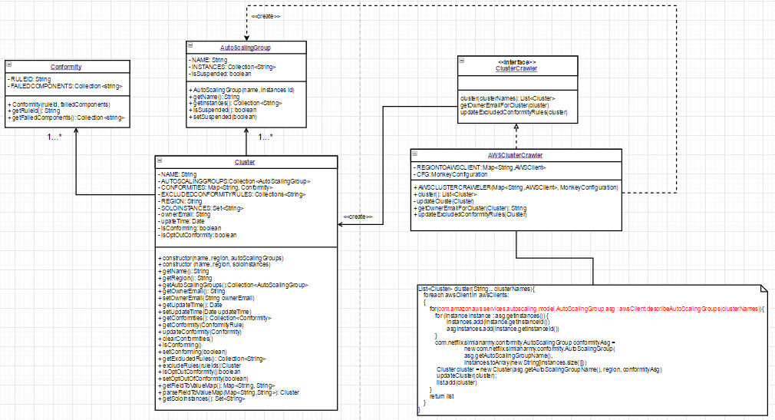
Problem-2: How to replace Auto Scaling Groups
(from: https://groups.google.com/forum/#!topic/simianarmy-users/4l1veoxU3NE)
Q: Replace ASG with a third-party tool to handle scaling of my EC2 instances .
A: They assume the structure of aws cluster which contains ASGs which contains instances. If you want, you can fork it and modify the iteration over instances to be in a way that doesn't use ASGs.
Violate the Open/Closed Principle !!!

Slide 53
Janitor Monkey

Slide 54

What does Janitor Monkey Do
Automatically cleans up the resources that are no longer needed.
Mark the resources
Notify the owners
Cleanup the resources
Notes:
根據某些規則 (RuleEngine) 決定怎樣的 Resource 算是 unneeded
跟 Owner 確認這些 Resource 真得不要了 (會給 termination time)

Slide 55
Requirement Statements
Janitor Monkey marks resources that are no longer needed, aka invalid.
For each resource type, there are some rules determining whether the resource is valid. For example, type ASG has OldEmptyASG and SuspendedASG rules, while type ELB has OrphanedELB and OldDetachedELB rules.
After marking the resources, Janitor Money will send a notification email to the owner of the each marked resource. Afterwards, Janitor Monkey will cleanup the marked resources.
Notes:
根據某些規則 (RuleEngine) 決定怎樣的 Resource 算是 unneeded
跟 Owner 確認這些 Resource 真得不要了 (會給 termination time)

Slide 56
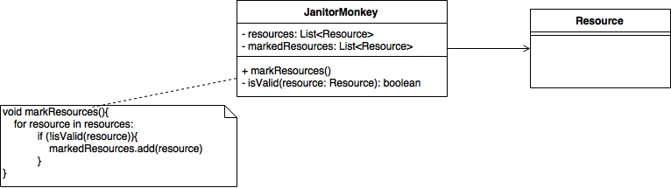
Requirement₁
Janitor Monkey marks resources that are no longer needed, a.k.a invalid.
Notes:
根據某些規則 (RuleEngine) 決定怎樣的 Resource 算是 unneeded
跟 Owner 確認這些 Resource 真得不要了 (會給 termination time)

Slide 57
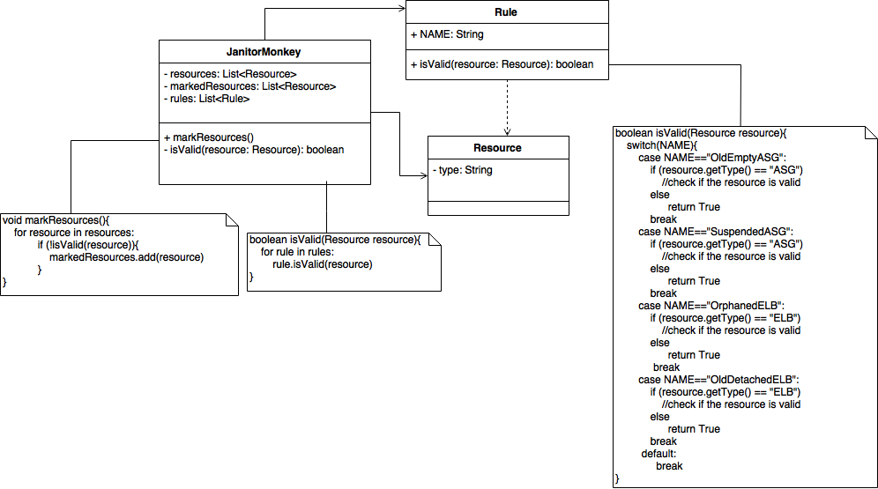
Requirement₂
For each resource type, there are some rules determining whether the resource is valid. For example, type ASG has OldEmptyASG and SuspendedASG rules, while type ELB has OrphanedELB and OldDetachedELB rules.
Notes:
根據某些規則 (RuleEngine) 決定怎樣的 Resource 算是 unneeded
跟 Owner 確認這些 Resource 真得不要了 (會給 termination time)

Slide 58
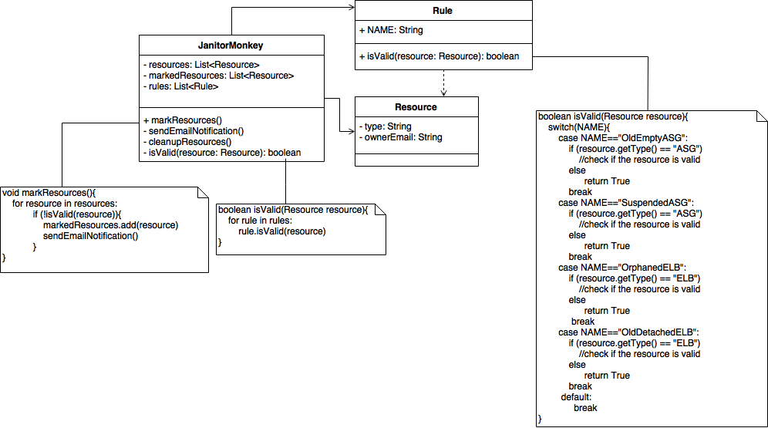
Requirement₃
After marking the resources, Janitor Money will send a notification email to the owner of the each marked resource. After that, Janitor Monkey will cleanup the marked resources.
Notes:
根據某些規則 (RuleEngine) 決定怎樣的 Resource 算是 unneeded
跟 Owner 確認這些 Resource 真得不要了 (會給 termination time)

Slide 59
Initial Design
If we want to add new rules, we have to modified existed class, which violates
Open/Closed Principle
Notes:
根據某些規則 (RuleEngine) 決定怎樣的 Resource 算是 unneeded
跟 Owner 確認這些 Resource 真得不要了 (會給 termination time)

Slide 60
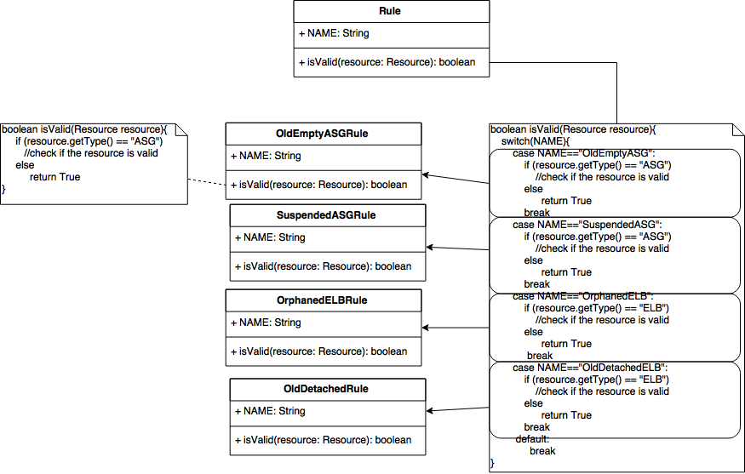
Encapsulate what varies
Encapsulate each rule into a concrete class.
Notes:
根據某些規則 (RuleEngine) 決定怎樣的 Resource 算是 unneeded
跟 Owner 確認這些 Resource 真得不要了 (會給 termination time)

Slide 61
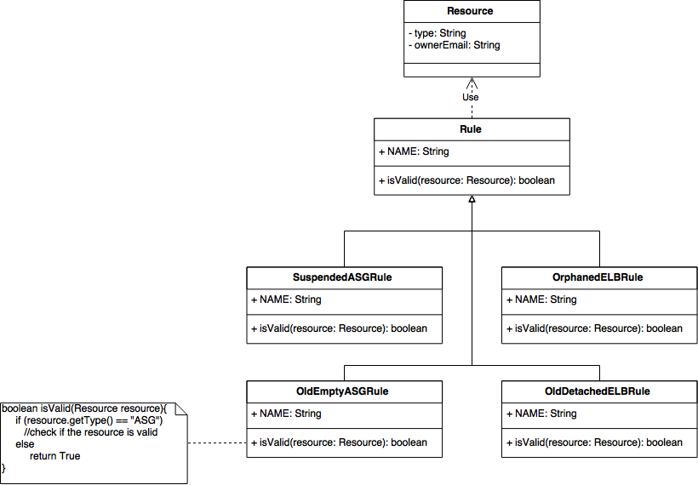
Abstract Common Behaviors₁
Make each rule extend the abstract class Rule.
Notes:
根據某些規則 (RuleEngine) 決定怎樣的 Resource 算是 unneeded
跟 Owner 確認這些 Resource 真得不要了 (會給 termination time)

Slide 62
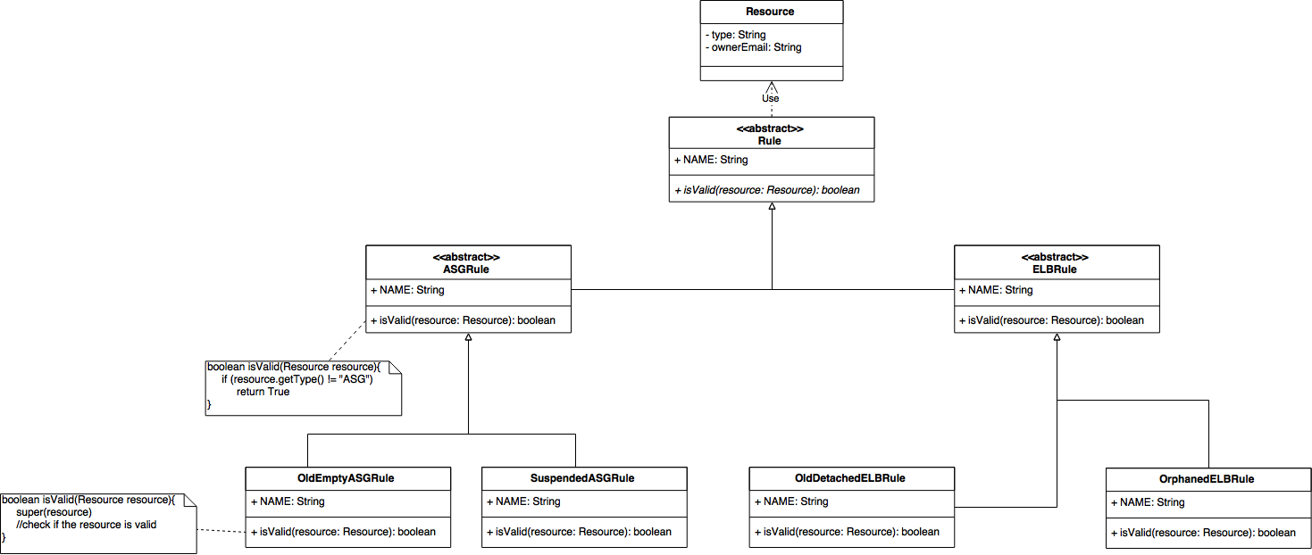
Abstract Common Behaviors₂
Use an abstract class to classify rules based on resource type they deal with, and implement type check in the abstract class.
Notes:
根據某些規則 (RuleEngine) 決定怎樣的 Resource 算是 unneeded
跟 Owner 確認這些 Resource 真得不要了 (會給 termination time)

Slide 63
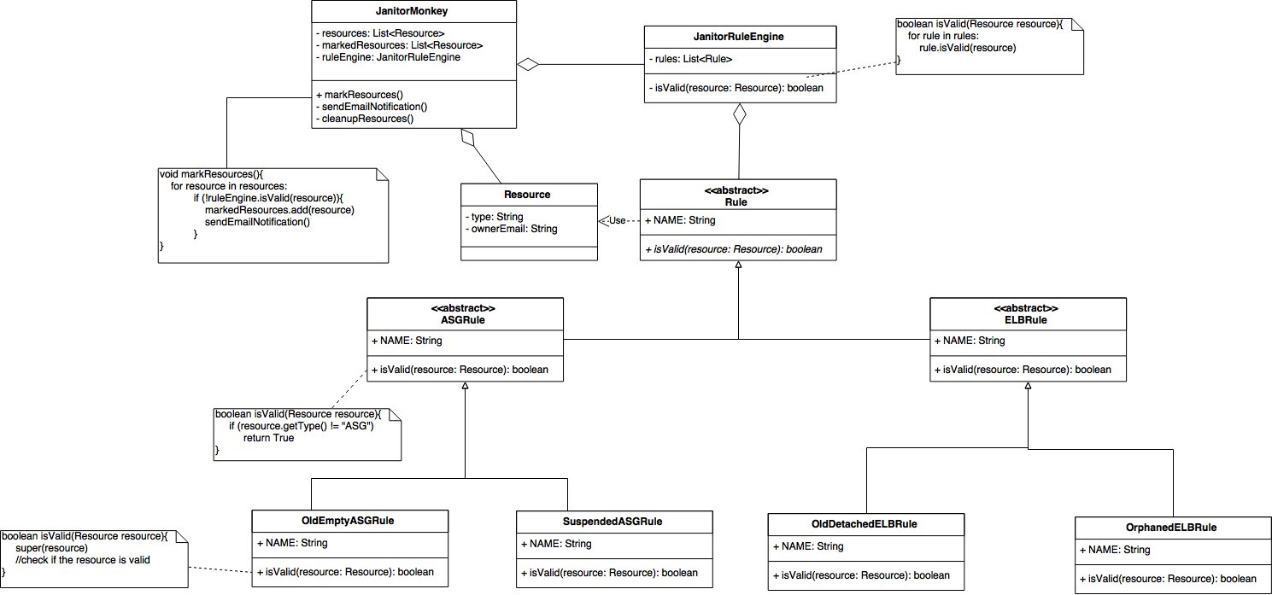
Single Responsibility Principle
Add JanitorRuleEngine to deal with all the stuff about rules.
Notes:
根據某些規則 (RuleEngine) 決定怎樣的 Resource 算是 unneeded
跟 Owner 確認這些 Resource 真得不要了 (會給 termination time)

Slide 64
Refactored Design
Notes:
根據某些規則 (RuleEngine) 決定怎樣的 Resource 算是 unneeded
跟 Owner 確認這些 Resource 真得不要了 (會給 termination time)

Slide 65
Class Diagram

Slide 66
Client

Slide 67
Introduction₁
For those who need to interact with AWS cloud.
CloudClient : Provides the interface for the monkeys.(To terminate the instances, delete ASGs, open an ssh connection etc.)
AWSClient : Implements CloudClient, being a client interface for Simple Amazon EC2 and Amazon ASG.
VSphereClient : Extends AWSClient, Terminate the VMs with the configured TerminationStrategy

Slide 68
Introduction₂
For monkeys who want to talk to RESTful web services.
MonkeyRestClient : A REST client which can get response in JSON and get the base url of the service.
EddaClient : Extends MonkeyRestClient, accessing Edda to get the history of a cloud resource.

Slide 69
Introduction₃
For monkeys who wants to access Eureka service.
ConformityEurekaClient : Provides an interface to get the status of instances for Conformity Monkey.
BasicConformityEurekaClient : Implements a client to access Eureka for getting instance information used by Conformity Monkey.

Slide 70
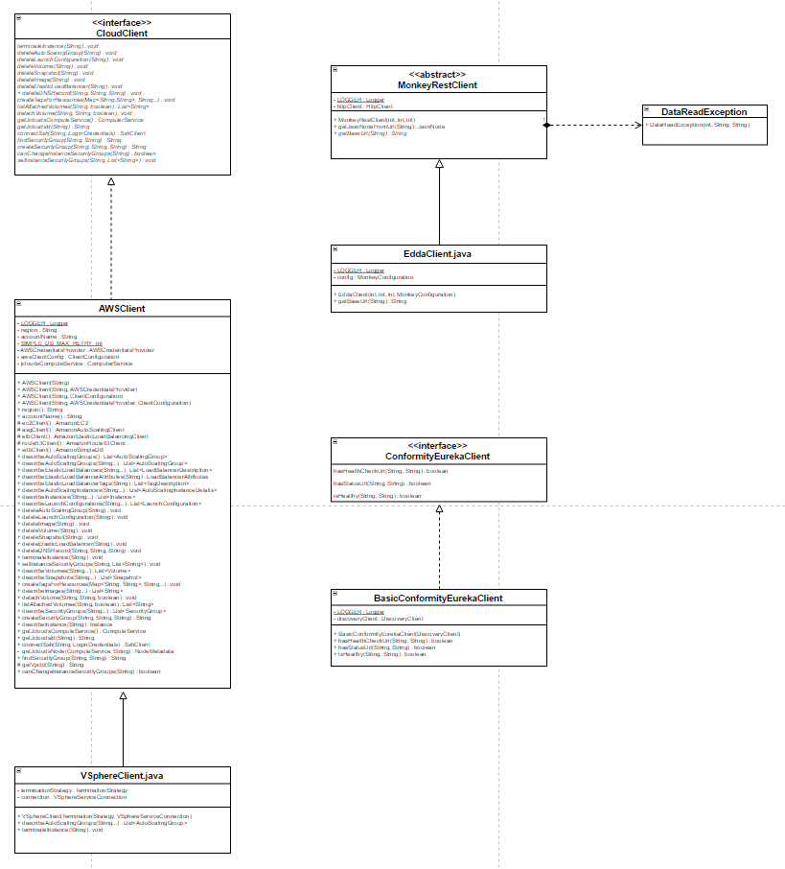
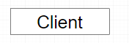
Structure
MonkeyRestClient
CloudClient
DataReadException
EddaClient
ConformityEurekaClient
AWSClient
BasicConformityEurekaClient
VSphereClient

Slide 71
Multi-Thread – ways to synchronize

Slide 72
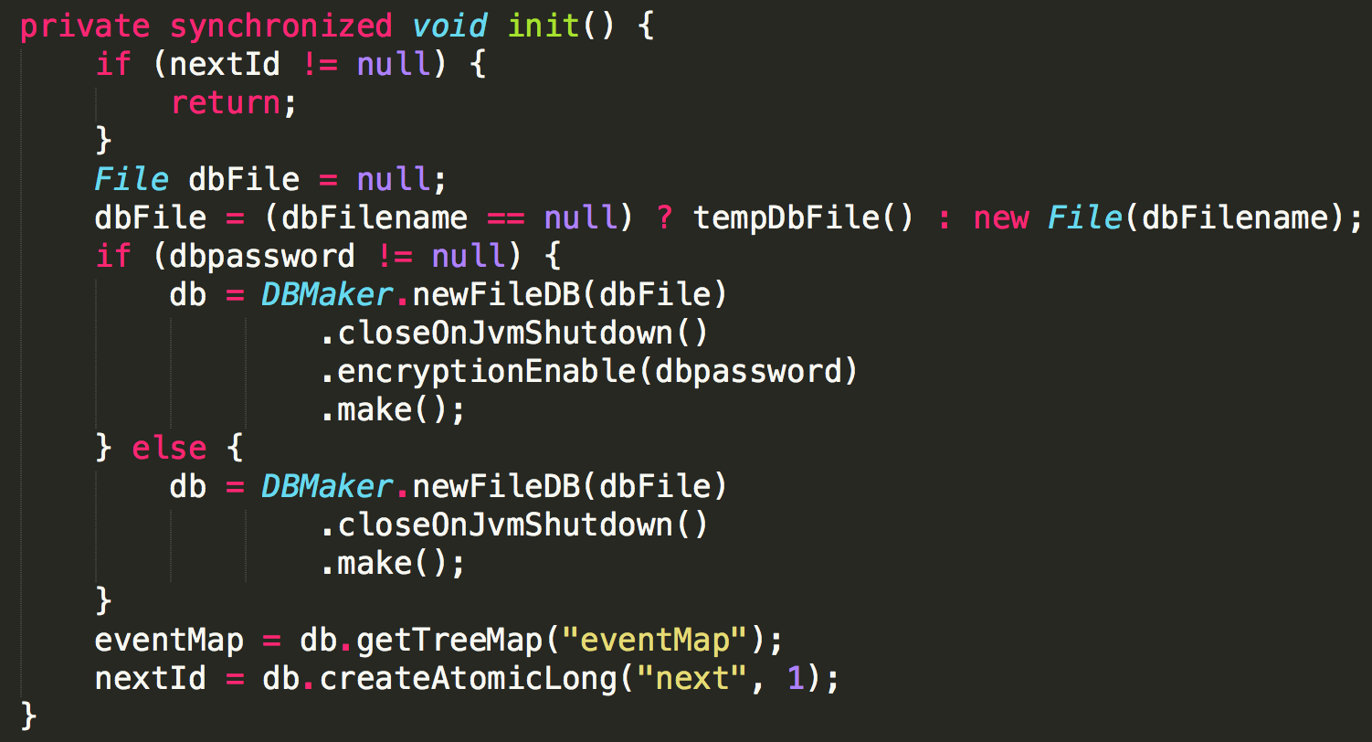
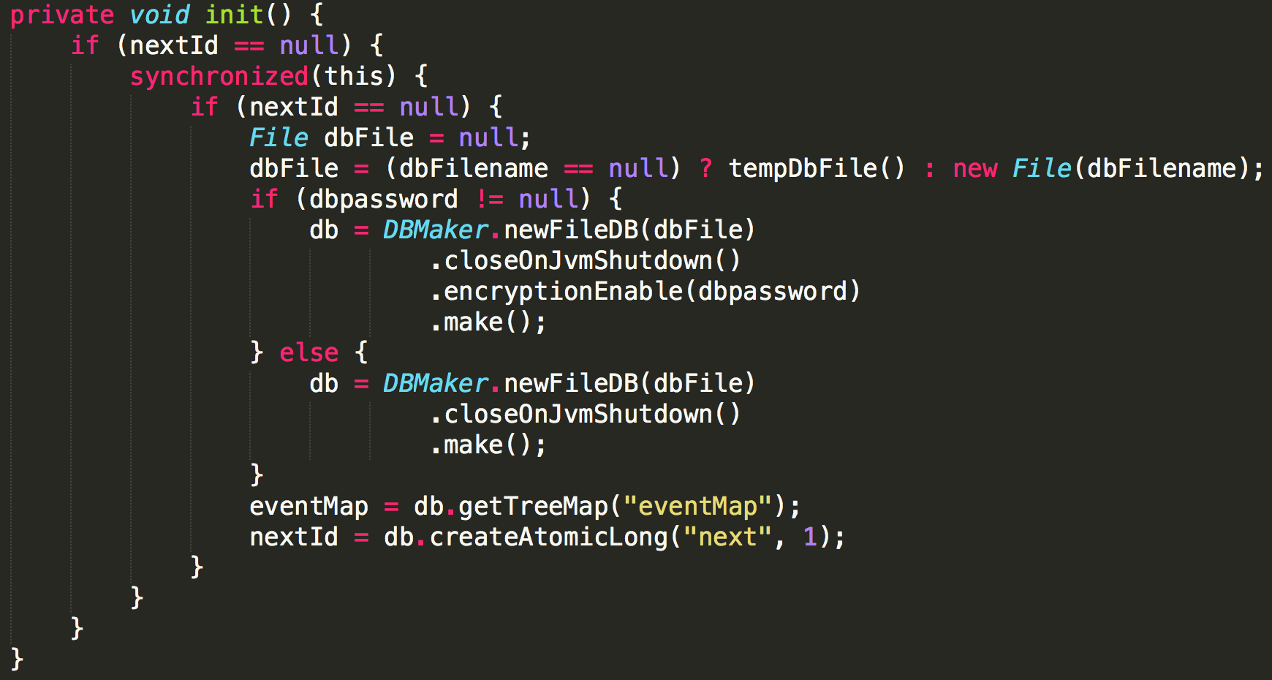
AWSClient
Initial implementation.
Refactored implementation.

Slide 73
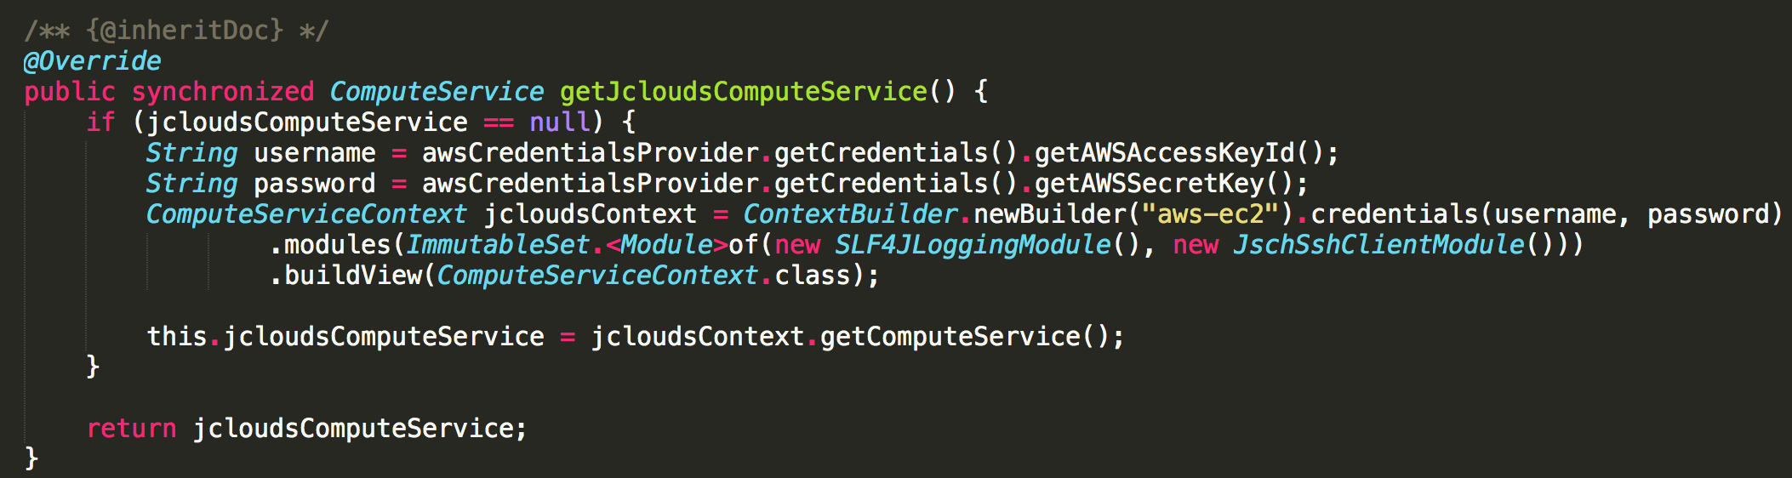
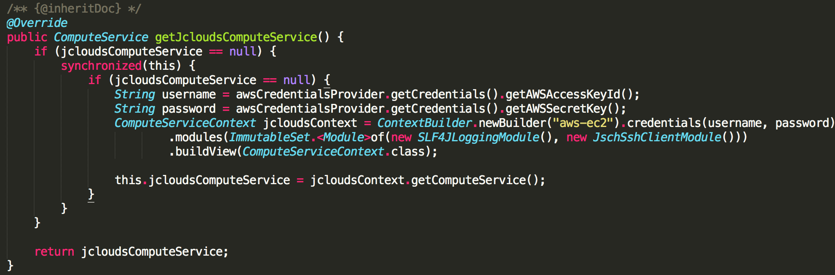
LocalDbRecorder
Initial implementation.
Refactored implementation.

Slide 74
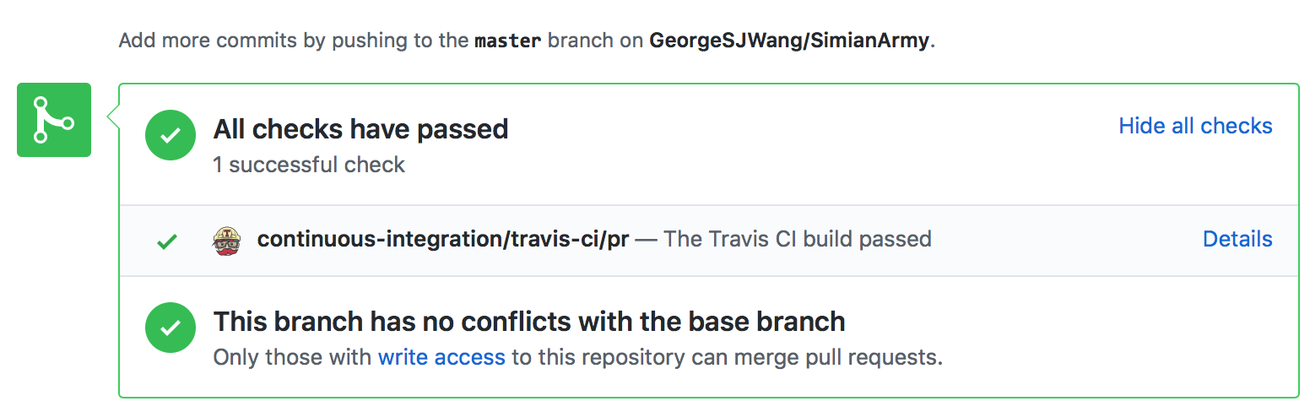
GitHub Pull Request
Pull request was submitted last Thursday.
It is now pending and waiting to be merged.

Slide 75
Crawler

Slide 76
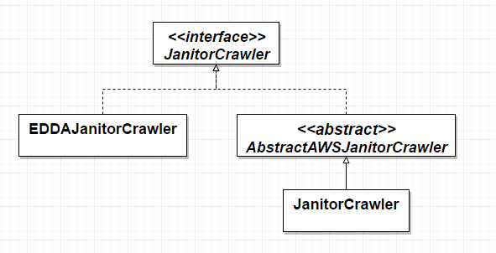
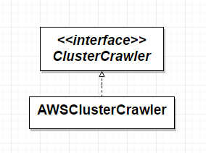
Simplified Architecture

Slide 77
How to achieve?
AWS-based :
take InstanceJanitorCrawler as an example
EDDA-based:
take EDDAInstanceJanitorCrawler as an example

Slide 78
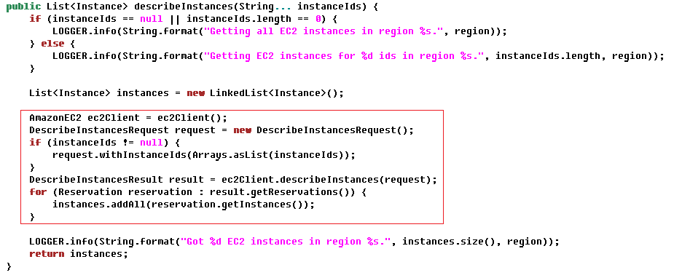
AWS-Based

Slide 79
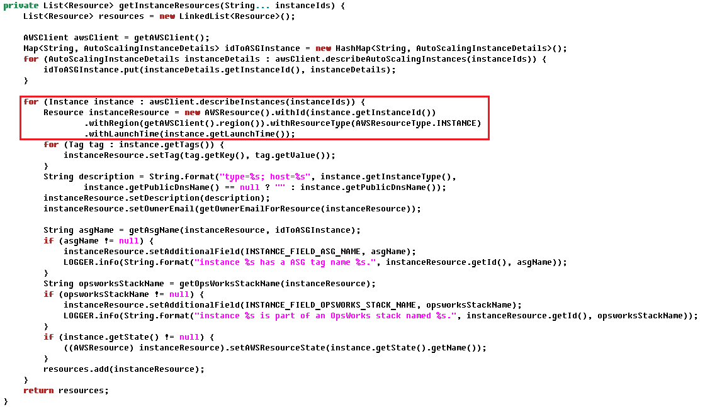

Slide 80
EDDA-Based

Slide 81
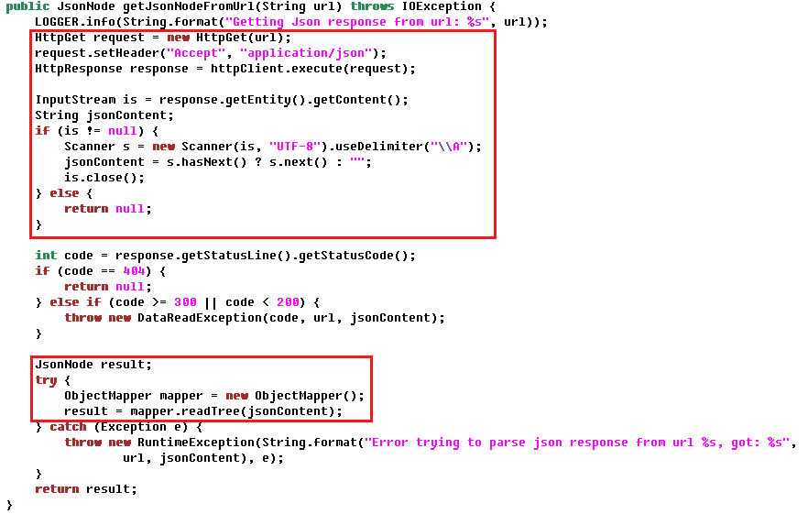

Slide 82
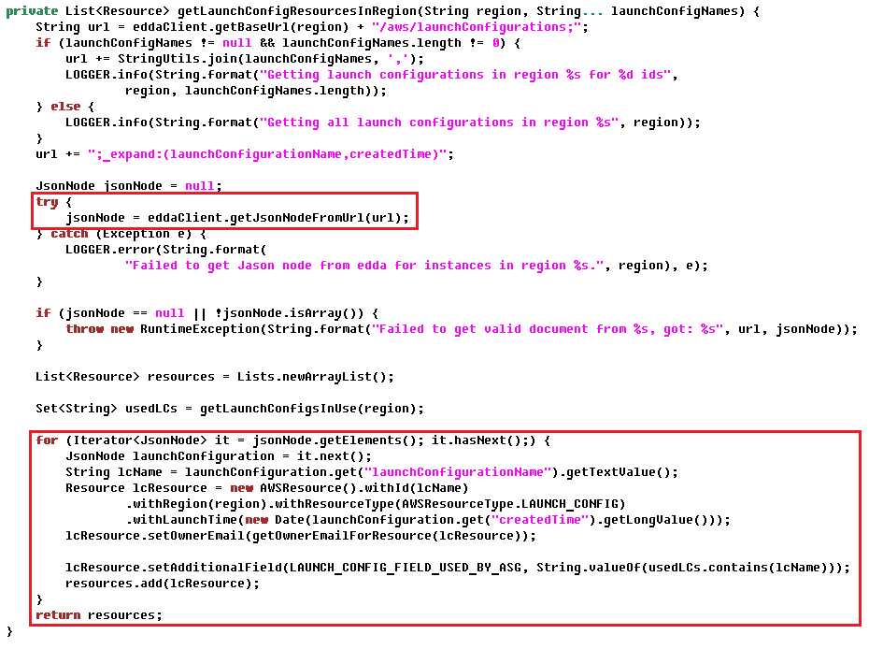

Slide 83

Class Diagram

Slide 84

Initial Design
For later purposes, only showing two of the six AWS-Based crawlers here.

Slide 85
Issue
All Crawler classes will be modified if the algorithm of get___Resource() is changed! * ____ could be either: ELB, Instance… etc for ELBCrawler, InstanceCrawler… etc respectively.

Slide 86
Solution – Template Method Pattern

Slide 87

Act 1: Encapsulate What Varies
Encapsulate a method into a concrete class.

Slide 88

Act 2: Abstract Common Behaviors
Abstract common behaviors with a same signature into abstract class through inheritance.

Slide 89
Possible Scenario
If the algorithm of getResources(String) is modified, now only ONE abstract class needs to be modified; rather than having to open all ___Crawler.java and make necessary modification in each code.

Slide 90
Utilities

Slide 91
Calendar
Open/Closed Principle
To add a new type of calendar, such as Chinese Calendar, simply needs extension of BasicCalendar class. Hence, not a single java code needs to be modified.

Slide 92

Calendar
Class diagram:

Slide 93

MonkeyRecorder
Initial Design

Slide 94

MonkeyRecorder
Dependency Inversion Principle

Slide 95
Self-Defined NotFoundExceptions - Adapter Pattern

Slide 96
Scenario
Simian Army defines a new class NotFoundException
Problem: Some outside exceptions should also be classified as NotFoundException
Solution: Use a wrapper to wrap those exceptions

Slide 97

Class Diagram
Notes:
Client -> any class trying to catch NotFoundException
First constructor in Adaptor -> for inside exceptions; The other constructors -> for outside exceptions
Adaptor aggregates Adaptee -> next slide

Slide 98

Class Diagram
Notes:
Only depicts one constructor, but the concept of the other one is the same

Slide 99

Inside SimianArmy
terminateNow() in BasicChaosMonkey.java

Slide 100

Outside SimianArmy
detachVolume() in AWSClient.java

Slide 101

Client
addTerminationEvent() in ChaosMonkeyResource.java
The client only needs to know the exception belongs to NotFoundException, the adapter hides all the other details.
Notes:
If it is a NotFoundException, then doSomething()

Slide 102
Coding Style

Slide 103

TODO Comments

Slide 104

Logger

Slide 105

Annotations

Slide 106
Javadoc Comment

Slide 107


Slide 108
Q & A

